Slide 1
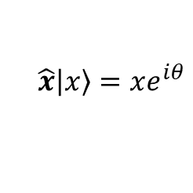
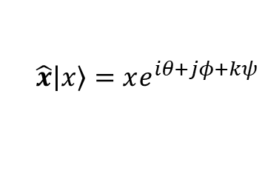
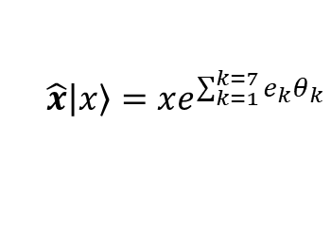
$実数量子\left|\left.x\right\rangle \right.$の三様の波束の収縮
further outside spaces
$$実数量子\left|\left.x\right\rangle \right.$$
$$\hat{x}\left|\left.x\right\rangle \right.=xe^{\sum_{k=1}^{k=7}{e_{k}}θ_{k}}$$
$$\hat{x}\left|\left.x\right\rangle \right.=xe^{iθ+jφ+kψ}$$
八元数
四元数
$$\hat{x}\left|\left.x\right\rangle \right.=xe^{iθ}$$
複素数
$$実数x$$
Jun Saito 20240401 rev.1

