Slide 1
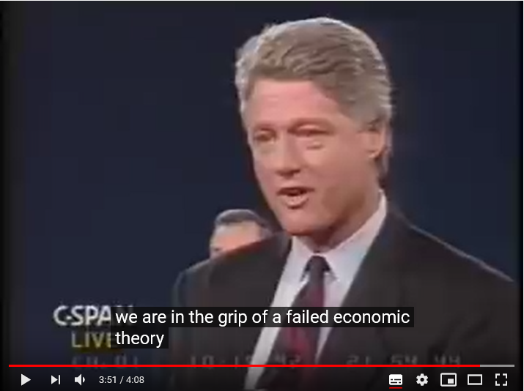
economic substance doctrine
2009 codified by Obama
Clinton vs. Bush
in 1992 Debate
In a failed economic theory

Slide 3
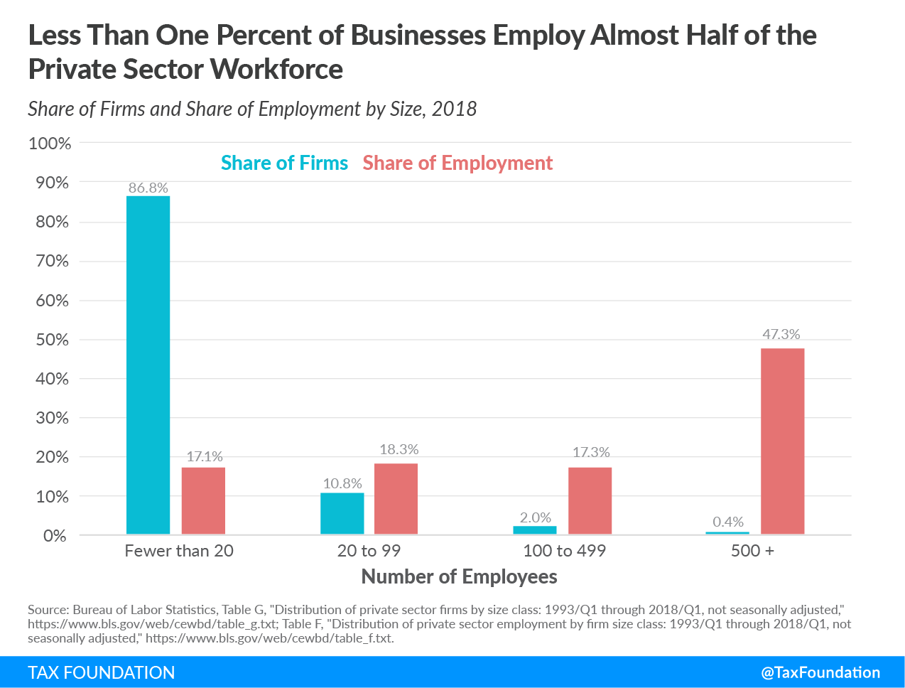
出典： https://taxfoundation.org/firm-variation-employment-taxes/

